Slide 1
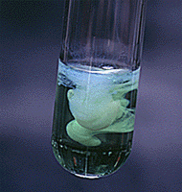
Solubility Equilibria
Chapter 16

Slide 2
16.1 Solubility Equilibria and the Solubility Product
16.2 Precipitation and Qualitative Analysis

Slide 3
Solubility Equilibria (for slightly soluble solids)
AgCl (s) Ag⁺ (aq) + Cl⁻ (aq)
K_{sp} = [Ag⁺][Cl⁻]
K_{sp} is the solubility product constant
MgF₂ (s) Mg²⁺ (aq) + 2F⁻ (aq)
K_{sp} = [Mg²⁺][F⁻]²
Ag₂CO₃ (s) 2Ag⁺ (aq) + CO₃²⁻ (aq)
K_{sp} = [Ag⁺]²[CO₃²⁻]
Ca₃(PO₄)₂ (s) 3Ca²⁺ (aq) + 2PO₄³⁻ (aq)
K_{sp} = [Ca²⁺]³[PO₄³⁻]²
Dissolution of an ionic solid in aqueous solution:
Q < K_{sp}
Unsaturated solution
No precipitate
Q = K_{sp}
Saturated solution
Q > K_{sp}
Supersaturated solution
Precipitate will form
16.6

Slide 4
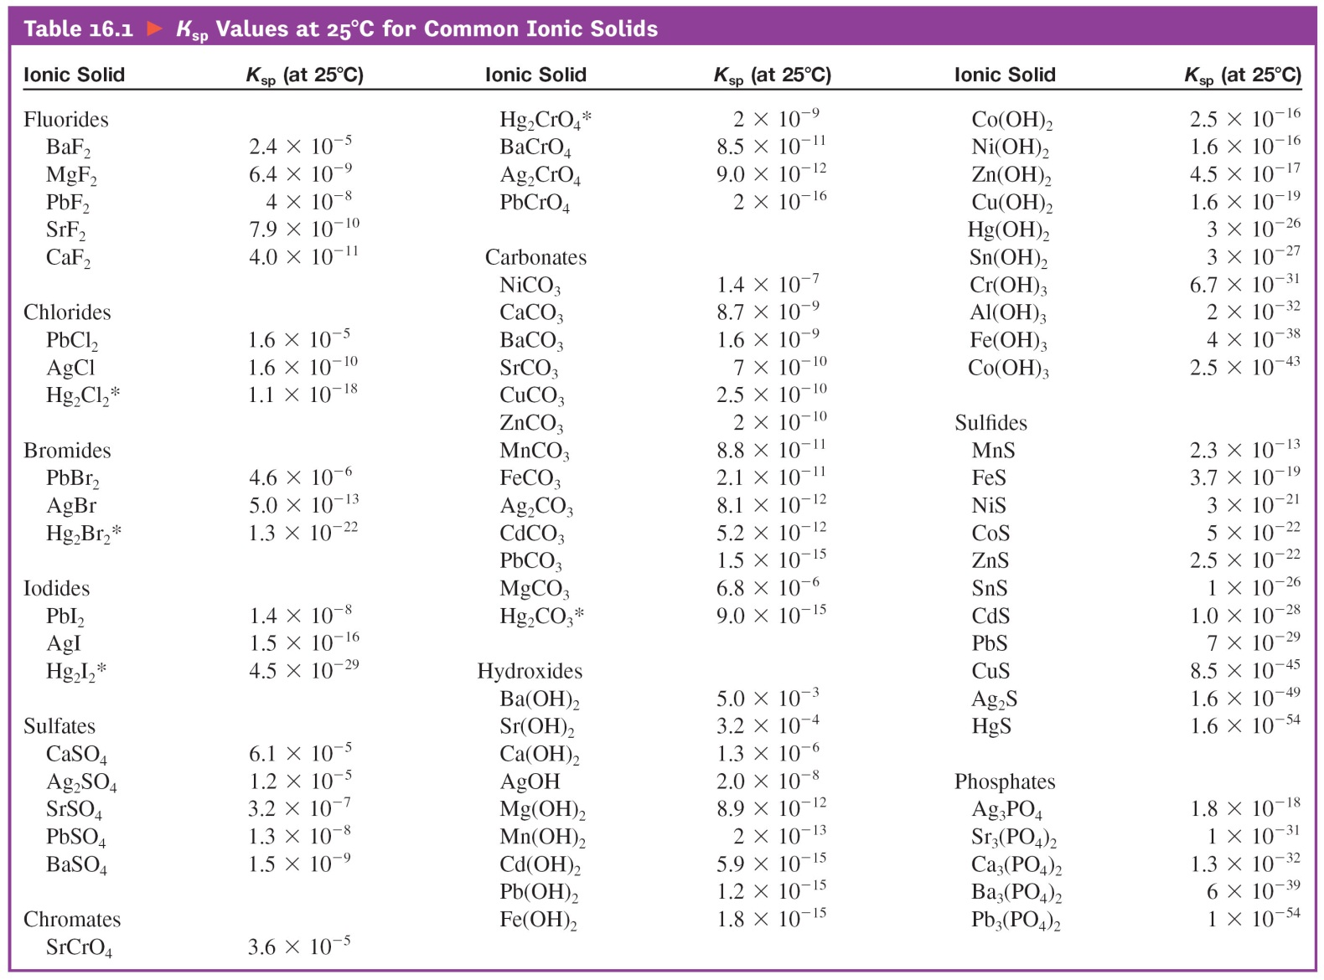
Ksp Values at 25 deg C for Common Ionic Solids

Slide 5
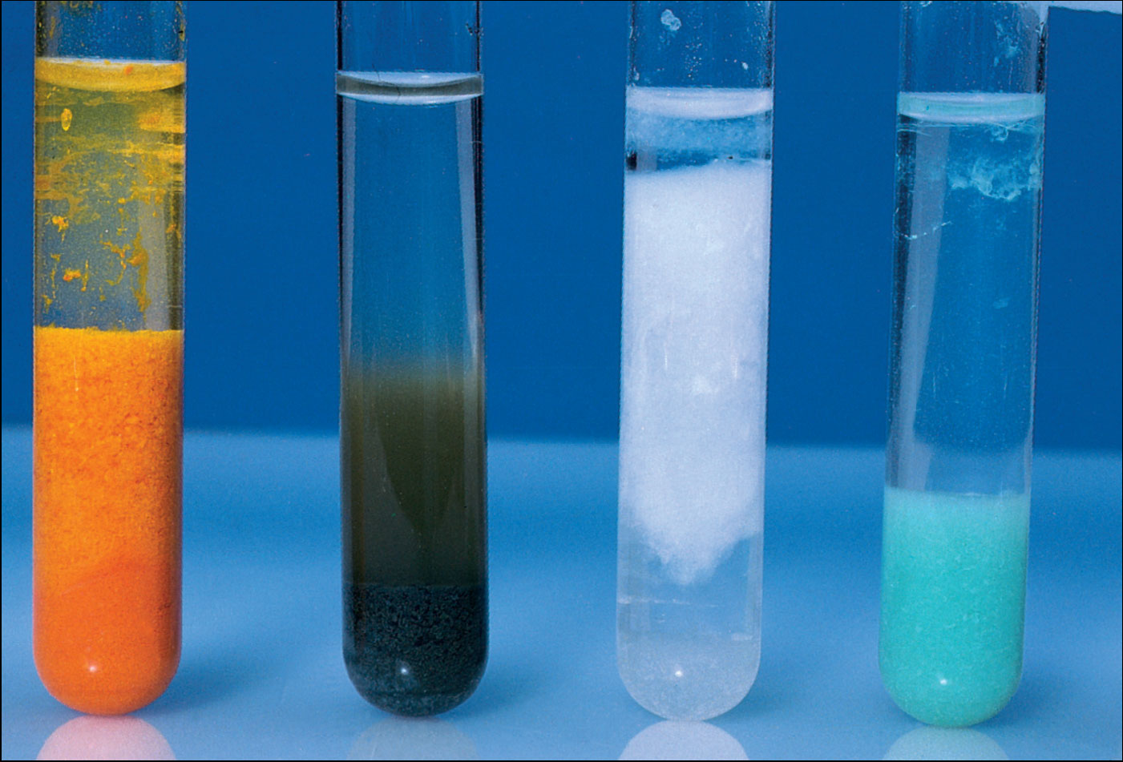
Insoluble Carbonates
Photo © Brooks/Cole, Cengage Learning Company. All rights reserved.

Slide 6
Solving Ksp problems
Ag₂CO_{3 (s)}
Ksp =
I
C
E

Slide 7
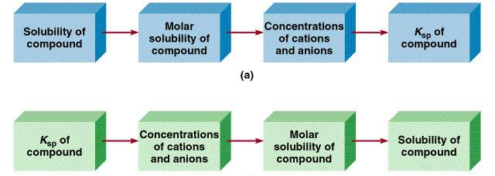
Molar solubility (mol/L) is the number of moles of solute dissolved in 1 L of a saturated solution.
Solubility (g/L) is the number of grams of solute dissolved in 1 L of a saturated solution.
16.6

Slide 8
What is the solubility of silver chloride in g/L ?
AgCl (s) Ag⁺ (aq) + Cl⁻ (aq)
K_{sp} = 1.6 x 10⁻¹⁰
Initial (M)
0.00
0.00
K_{sp} = [Ag⁺][Cl⁻]
Change (M)
+s
+s
K_{sp} = s²
√
Equilibrium (M)
s
s
s = K_{sp}
s = 1.3 x 10⁻⁵
[Ag⁺] = 1.3 x 10⁻⁵ M
[Cl⁻] = 1.3 x 10⁻⁵ M
1.3 x 10⁻⁵ mol AgCl
143.35 g AgCl
Solubility of AgCl =
x
= 1.9 x 10⁻³ g/L
1 L soln
1 mol AgCl
16.6

Slide 9
If 2.00 mL of 0.200 M NaOH are added to 1.00 L of 0.100 M CaCl₂, will a precipitate form?
The ions present in solution are Na⁺, OH⁻, Ca²⁺, Cl⁻.
Only possible precipitate is Ca(OH)₂ (solubility rules).
Is Q > K_{sp} for Ca(OH)₂?
[Ca²⁺]₀ = 0.0998 M
[OH⁻]₀ = 3.99 x 10⁻⁴ M (be sure to add the volumes
& find new M)
2
= 0.0998 x (3.99 x 10⁻⁴)² = 1.59 x 10⁻⁸
Q = [Ca²⁺]₀[OH⁻]₀
K_{sp} = [Ca²⁺][OH⁻]² = 8.0 x 10⁻⁶
Q < K_{sp}
No precipitate will form
16.6

Slide 10
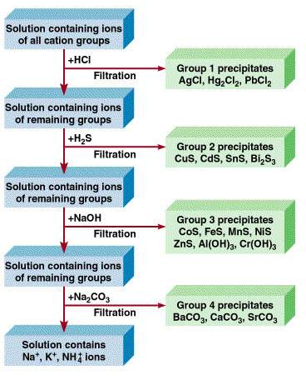
Qualitative Analysis of Cations
16.11

